Slide 1
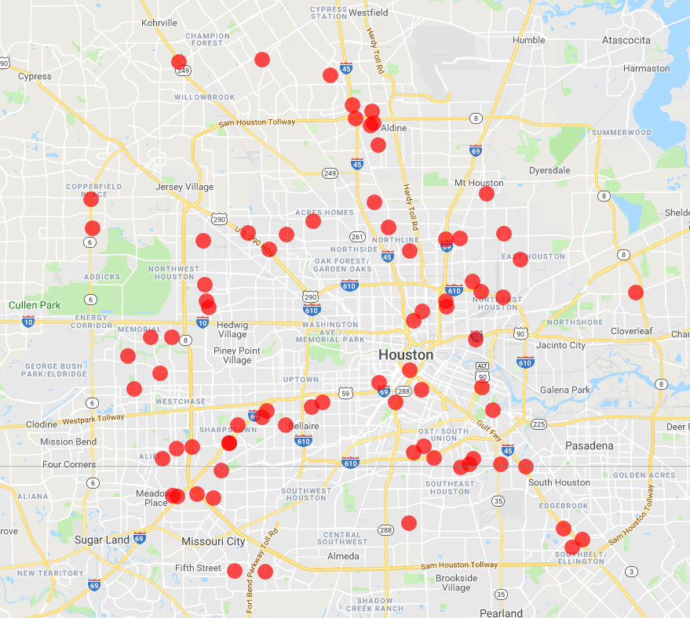
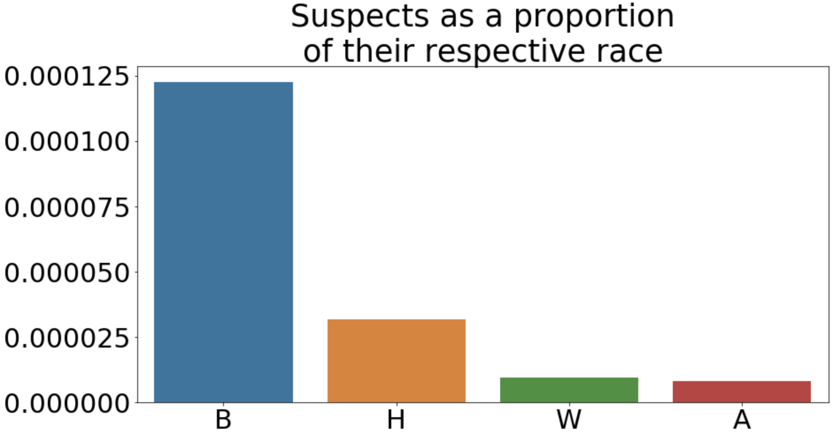
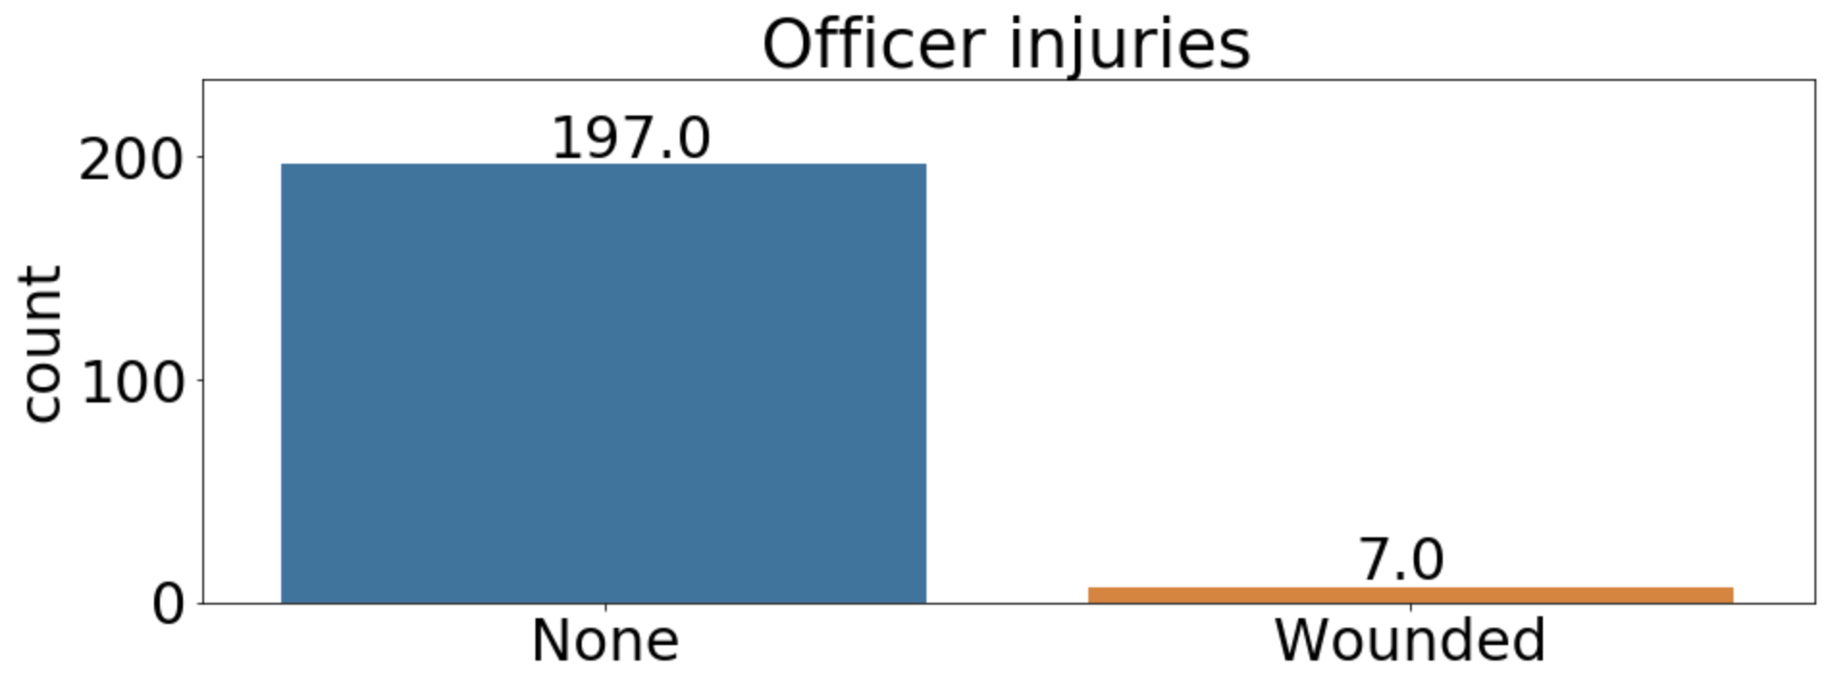
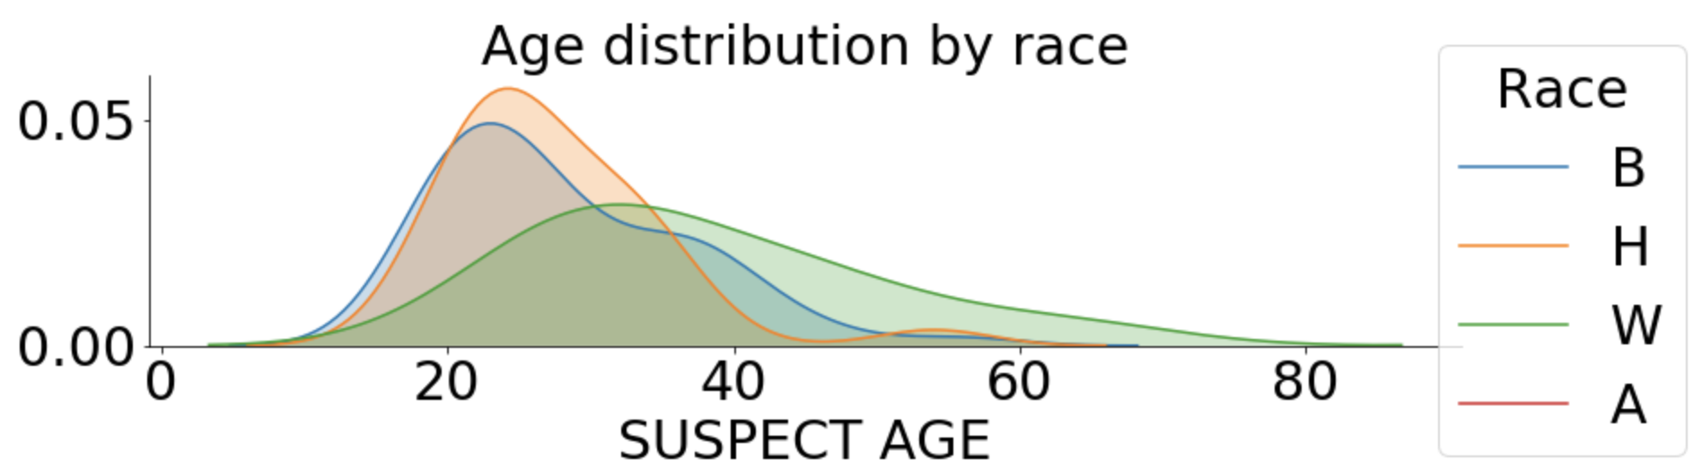
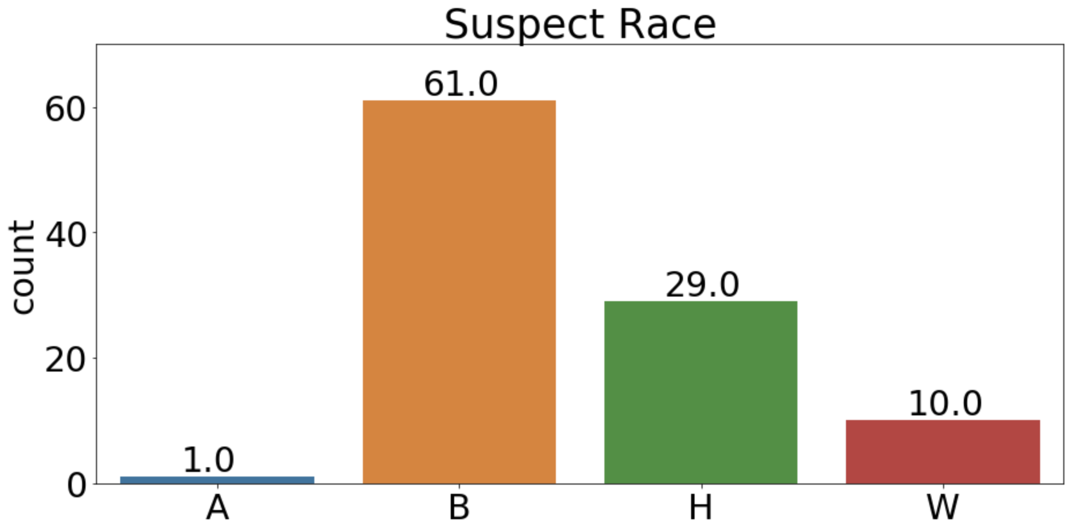
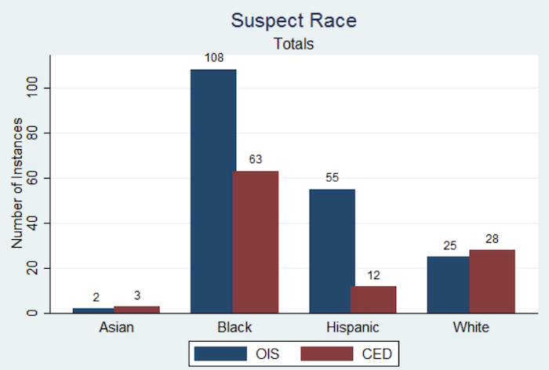
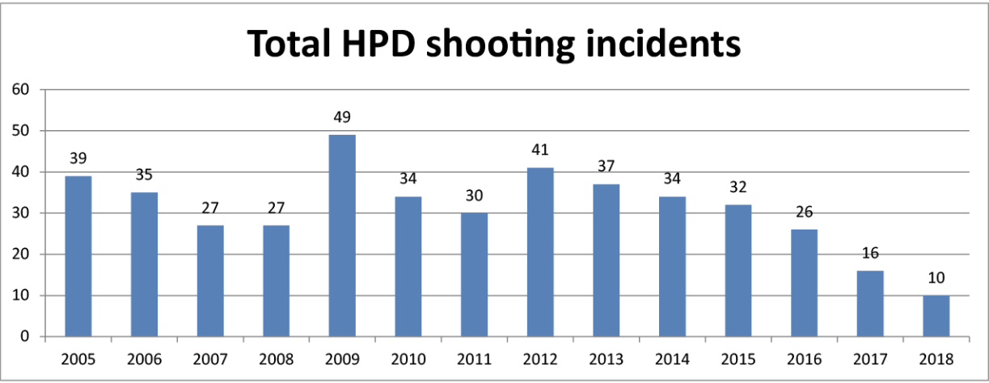
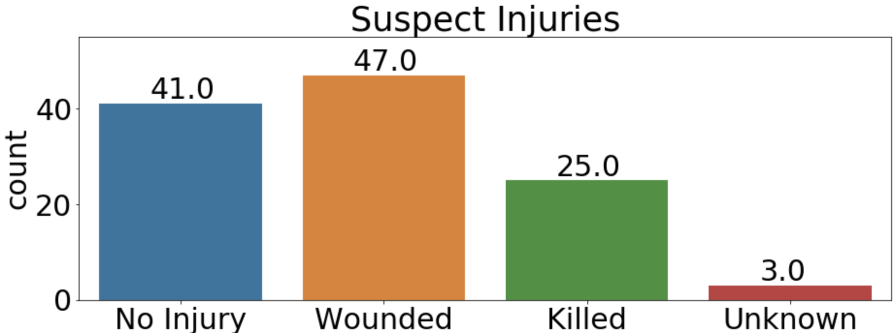
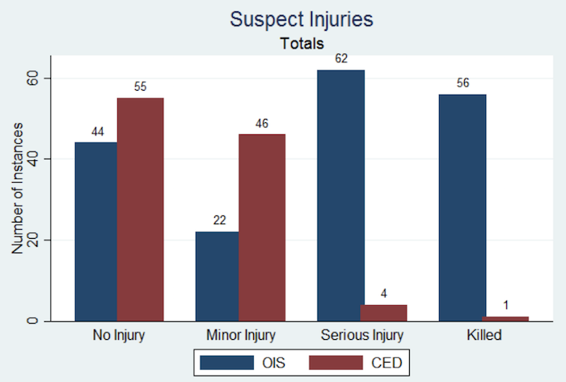
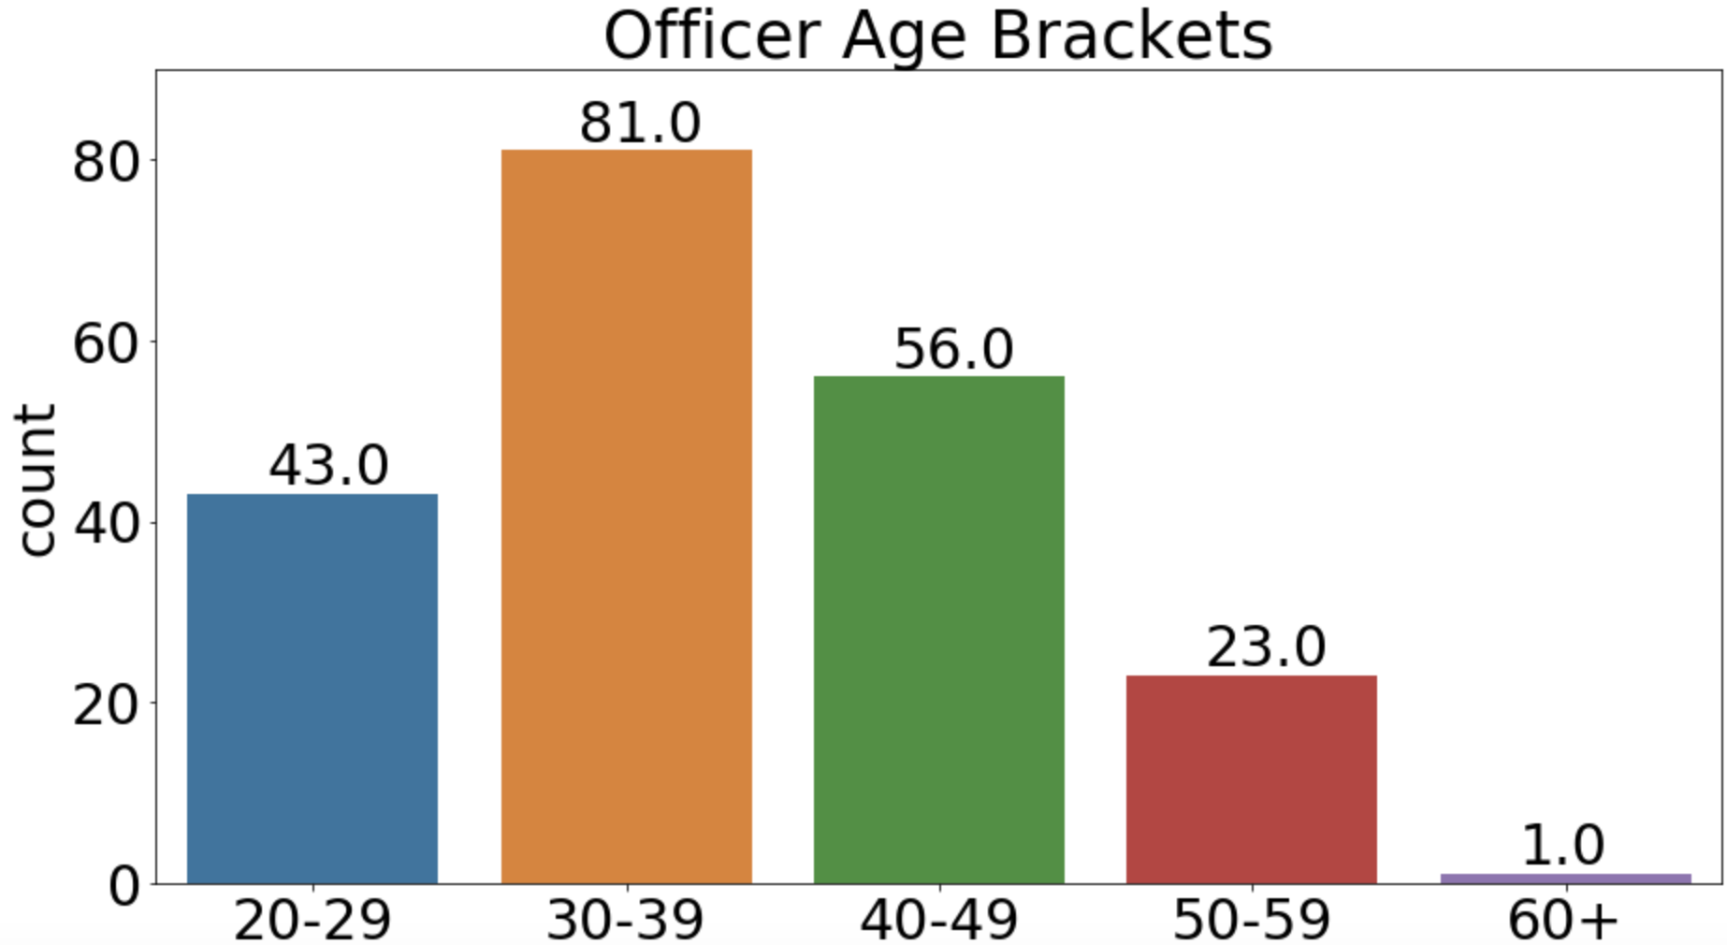
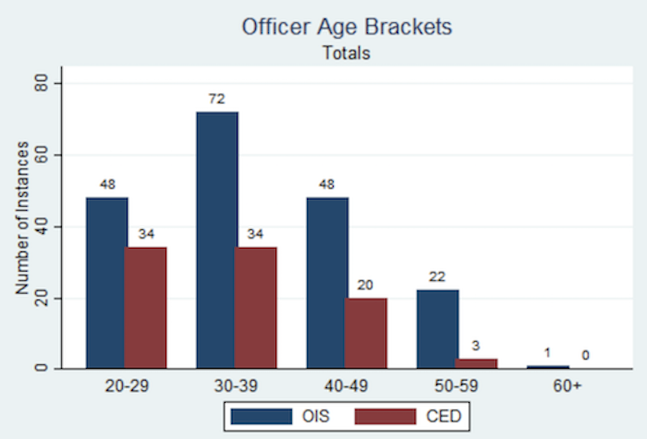
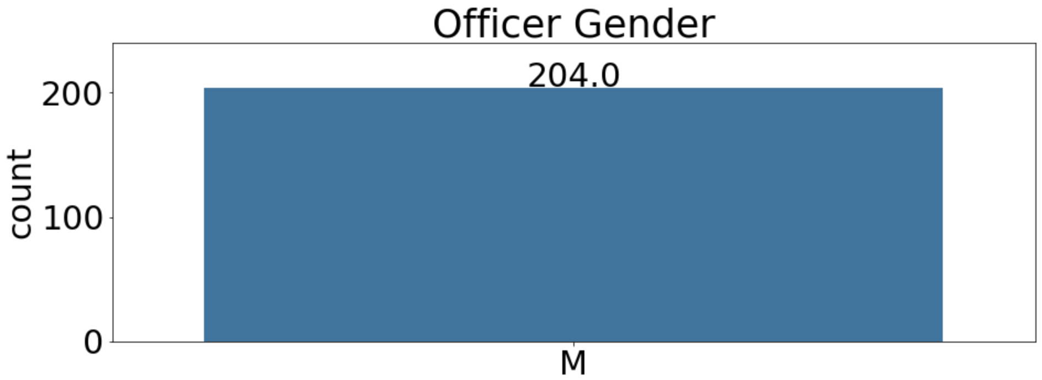
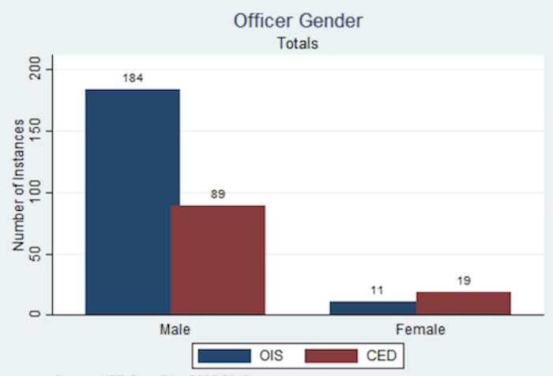
An Analysis of Houston Police Department Officer-Involved Shootings
Nevin George (Cinco Ranch High School) & Max Grossman (Rice University)
Background
Officer-involved shootings (OIS) have been an issue since the establishment of the first American police department in Boston in 1838
Texas State Legislature passed Art. 2.139 of the Texas Code of Criminal Procedure on 9/1/2015, which requires law enforcement agencies to report details of all officer-involved shootings
Since then, OIS per year in Houston has been monotonically decreasing
Geocoding the Data
Additional Statistics
Blacks are killed at a disproportionate number with respect to the population size of each race in Houston
Nationwide attention escalated following incidents such as the death of Michael Brown in Ferguson, MO
96.6% of officers in OIS sustain no injuries
Suspect Statistics
White suspects are on average around 10 years older than Black and Hispanic suspects
Insufficient data on Asian suspects
A - Asian
B – black
H – Hispanic
W – White
Previous Study
Average age of victims: Black – 28.1 White – 37.9
Hispanic – 27.4 Asian – 21.0
In both graphs, Black suspects make up 55-60% of OIS and Hispanic suspects around 28%
White suspects only make up 9-13%
Models
Tried different models to predict suspect injury
Decision Tree Classifier yielded a 91.67% accuracy score
Decision Tree first divides the population by suspect age with a pivot point of 23.5 years
Younger suspects are then divided by suspect weapon, and older suspects are divided by suspect age of 36.5 years
Decision Tree contains 7 layers and is divided by 11 different variables
Previous Study
Dataset & Previous Literature
HPD maintains open records of all OIS in Houston
A previous study by researchers at Northwestern University analyzed trends in the Houston OIS dataset from 2005 to 2013
Officer Statistics
Previous Study
Findings
No significant differences between the graphs of this data and those of the previous study
Lack of change adds evidence that the Act did in fact cause the sharp decline in police shootings
Could not have been caused by race, gender, etc. because those features did not change
Corroborate national police shooting trends such as evidence of racial bias, non-white suspects killed at younger age, and officers rarely injured
Questions
How much of the decrease in Houston OIS can be attributed to Article 2.139?
How do the trends of this data relate to the trends found in the previous study?
What are some new trends, if any, in this data?
What are the factors in a suspect being injured or killed in an encounter?
Both graphs have peaks at 30-39 years
Previous Study
Features Considered & Tools Used
Suspect/officer sex, race, age, injury
Suspect weapon, officer on duty, # of officers, and response type
Used Python, Pandas, matplotlib, Seaborn plots
Future Steps
The results of this study may be shared with the HPD, which could be useful when deciding future policies
Current data – 100% male officers
Previous study – 94% male officers
Male-dominated officer force

